Slide 1

Retail Sales Analysis
Analyzing 6.6M transactions to uncover market erosion patterns and optimize pricing strategy
Priyanshu Barjatia – Data Analyst (Python | SQL | Power BI)

Slide 2

Dataset Overview
6.6M
7
42
Total Transactions
Data Tables
Data Columns
Customer purchases analyzed
Relational architecture
Comprehensive attributes
Robust dataset spanning demographics, products, sales transactions, and employee performance with minimal data quality issues

Slide 3

Data Preparation & Engineering
01
Data Loading & Validation
Imported datasets, checked null values across all tables
02
Standardization
Renamed columns to snake_case for consistency
03
Feature Engineering
Created purchase_frequency_days, formatted dates, calculated pricing metrics
04
Sales Table Enhancement
Merged product data, calculated gross/net prices

Slide 4
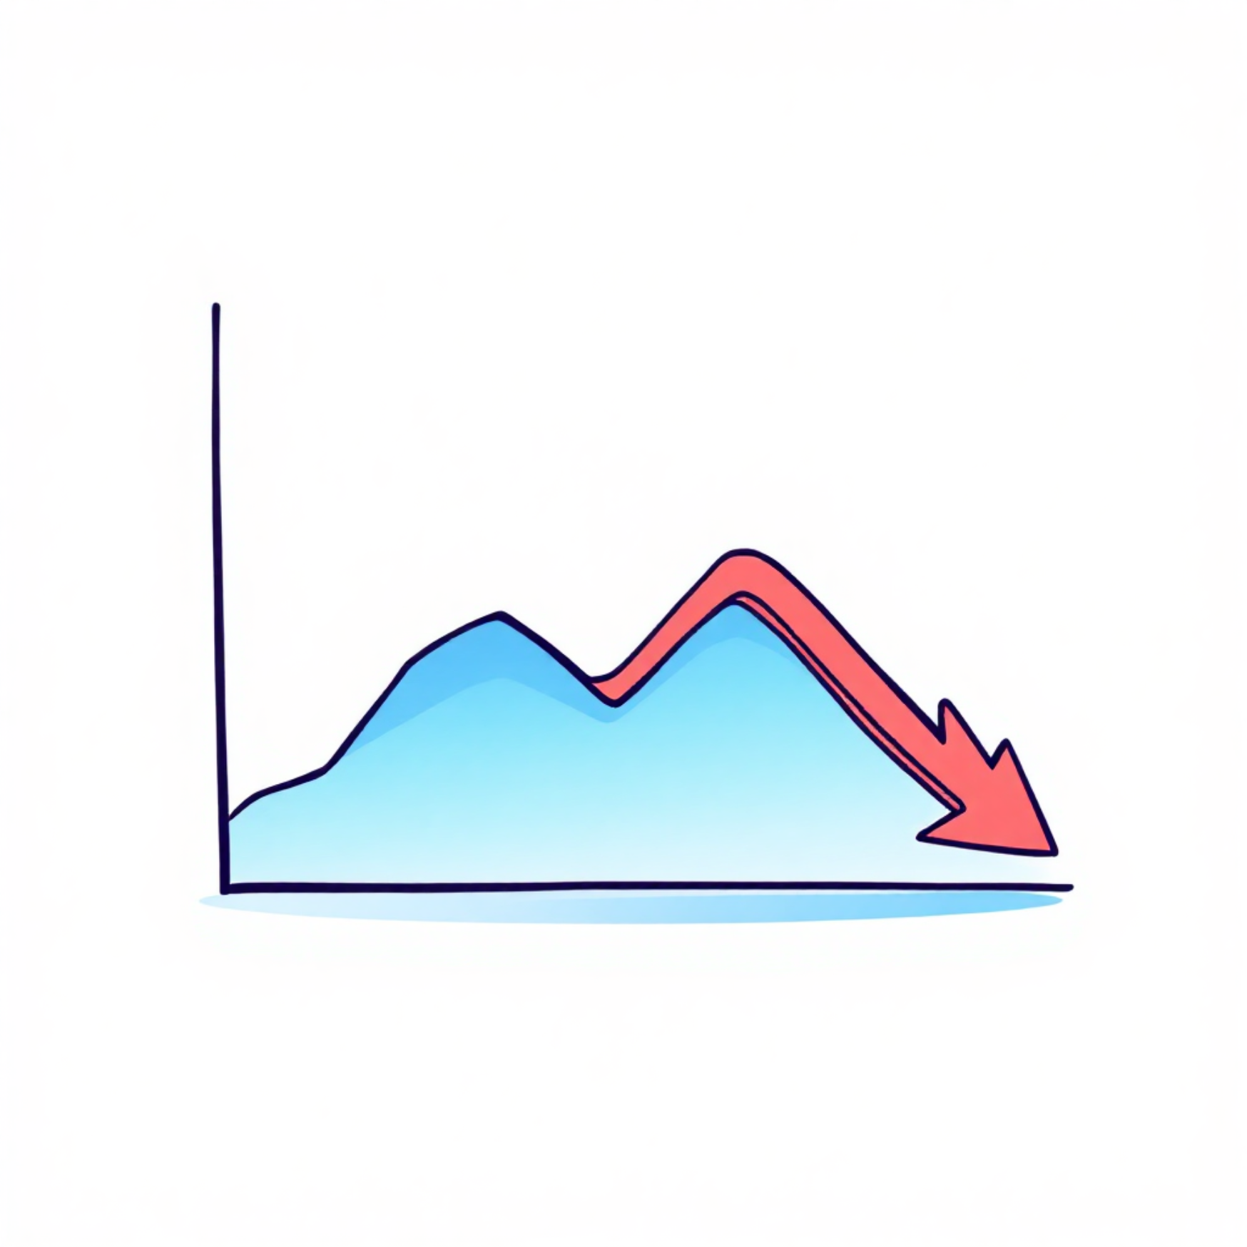
The Discount Dilemma
20% Discounts Erode Profitability
Revenue Comparison
10% Discount: $399M revenue, $596.53 AOV
20% Discount: $353M revenue, $529.46 AOV
Loss of $67 per order at 20% discount

Slide 5



Category Performance Analysis
Confections
Meat
Poultry
$551M revenue
$488M revenue
$436M revenue
Highest volume category with 11M units sold
9.6M units sold, strong performer
9M units, consistent demand

Slide 6


Product Distribution Insights
Product Categories
Tier Distribution
Price Range
Meat leads with 50 products, followed by Poultry (47) and Cereals (45)
Medium tier: 156 products, Low: 152, High: 143
$0.40 to $99.90, average $50.91
13
7.21
Average Quantity
Standard Deviation
Units per transaction
Demand volatility measure

Slide 7







Geographic Revenue Leaders
Tucson
Jackson
$48.3M revenue
$47.9M revenue
74,736 transactions
71,623 transactions
Sacramento
$47.7M revenue
73,667 transactions
Top markets show consistent performance with stable demand patterns across all cities

Slide 8



Sales Performance Metrics
82.5%
9.3%
8.2%
Full Price Sales
10% Discount
20% Discount
$3.5B at standard pricing
$399M revenue
$353M revenue
Demand Stability
Standard deviation: 7.21
Average quantity: 13 units
Low volatility indicates predictable demand patterns
Consistent purchase behavior across all segments

Slide 9

Geographic & Employee Performance
Top Revenue Cities
Top Sales Performers
Tucson: $48.3M
Devon Brewer: $188M
Jackson: $47.9M
Shelby Riddle: $188M
Sacramento: $47.7M
Katina Marks: $187M
Fort Wayne: $47.2M
Desiree Stuart: $187M
Consistent AOV across cities: $642-$648
Balanced performance across team

Slide 10




Strategic Recommendations
Eliminate 20% Discount
Drives $67 lower AOV than 10% across all categories and markets
Re-price Medium Tier
Highest volume but lowest revenue - clear underpricing relative to demand
Lean Inventory Strategy
Stable demand (7.21 volatility) enables low safety stock, freeing capital
Confections as Traffic Driver
Position highest-volume category strategically to boost cross-selling

Slide 11
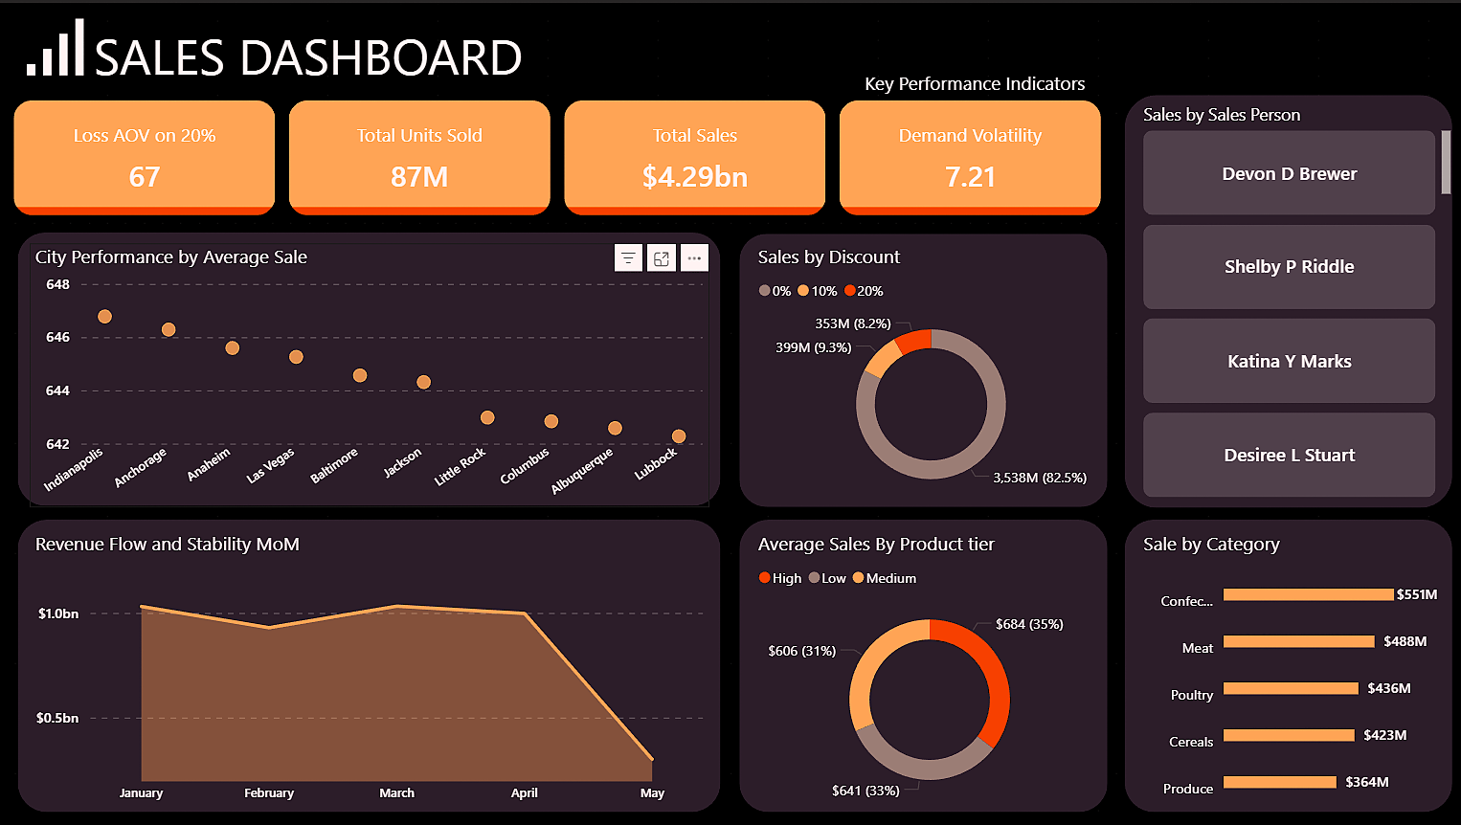
Power BI Dashboard

